Slide 1


Family Tree Analytics:
A Graph-Based Ancestral Exploration

Slide 2
Team Members
22BCE1082 - Sanjana Vivek
22BCE1225 - Nehaa Shri.M.S
22BCE1332 - Aadarsh Ramakrishna
22BCE1337 - Varshaa Puvvada Srinath

Slide 3
Abstract
This project is a python based solution for the creation and visualization of family tree and using Graphviz to display the family tree created in a .png format in a appealing way.It makes use of Python’s data manipulation .The project provides a clear depiction of the family tree through the code allows user to trace their family lineage.

Slide 4
MOTIVATION BEHIND PROJECT
We believe that the chosen project integrates our learning experiences in Data Structures with real world applications.
We believe that our project helps in
a)Preserving Family Tree
b)Simplifying Complex Family Structures
c)Enhancing Geological Research

Slide 5
CODING
The code of the family tree project is executed using Python coding language .
The design of the family tree builder project in Python using a graph data structure involve representing individuals as nodes in a graph and their familial relationships as edges. Each person in the family is a node with attributes like name, age, and other relevant information. Edges between nodes indicate parent-child relationships, and attributes on the edges are used to specify the nature of the relationship, such as "mother," "father," or "child". The project includes functionalities for adding ,deleting and editing family members and familial relationships , displaying the family tree, and generating visual representations of the family tree.

Slide 6
BACKEND
The backend is done using the pickle module in python. It converts the data into stream of bytes and stores in the binary file.To read the data stored it converts a stream of bytes to readable data.
The file in which the data has been stored will be available in the current directory ie the place where the program file is sorted in the local device.

Slide 7
VISUALIZATION OF THE FAMILY TREE
The depiction of the family tree project utilizes Graphviz which is a diagramming tool.
By using Graphviz, you can create a visually appealing and easy-to-understand representation of the users family history.
A DOT file is a text file that describes the nodes and edges of a graph. The nodes in a family tree represent the people in the family, and the edges represent the relationships between them.
The shape attribute is used to represent the shape of the nodes in the family tree.

Slide 8
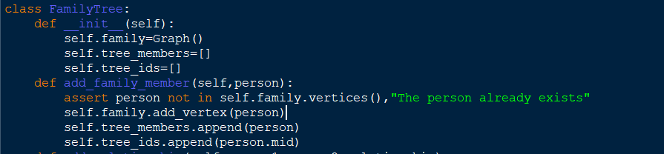
Linear Data Structure
Lists:
Lists are used to store the members of the family tree (tree_members and tree_ids in FamilyTree class). Lists provide sequential access to elements and are used for maintaining the order of family members and their corresponding IDs.

Slide 9
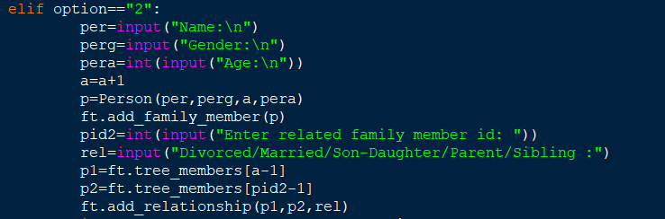
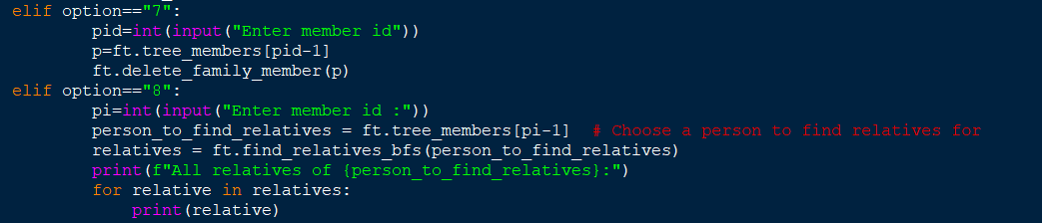
Uses of Lists in adding relations,deleting members and in finding the relatives of a family member. The Person object is obtained from the lists and used to add relationship with another member,or in deletion of the Person and in obtaining relatives of a person.

Slide 10
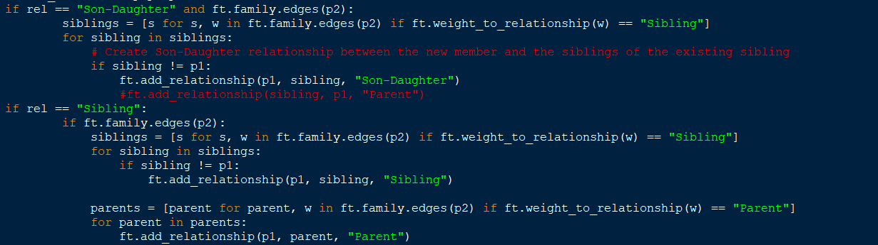
Lists are also used to obtain all the siblings or parents of a Person in order to instantiate relation between Parents and the Siblings of a family member.

Slide 11
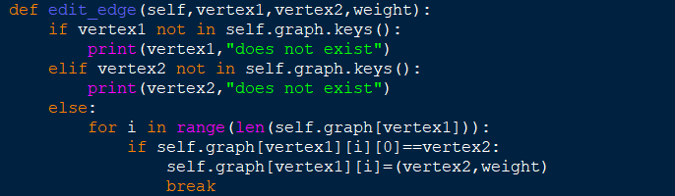
Searching Algorithms
Linear Searching Algorithm is used to edit edges in the graph in the edit_edge function inside Graph class, by forth meaning to be used in editing the relations of the family members in the family in the edit_relationship function in the class FamilyTree.

Slide 12
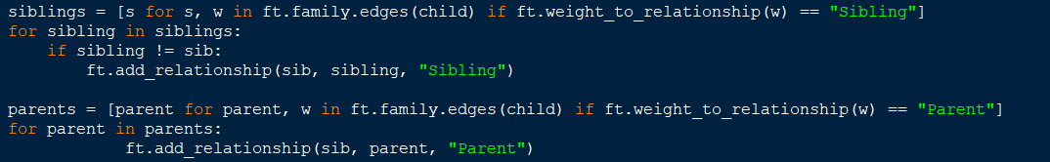
Linear searching algorithm is also used to find the siblings of a Person with the required condition and the parents of the Person under the required condition to create the relation between newly added family members with the already added family members instantly.

Slide 13
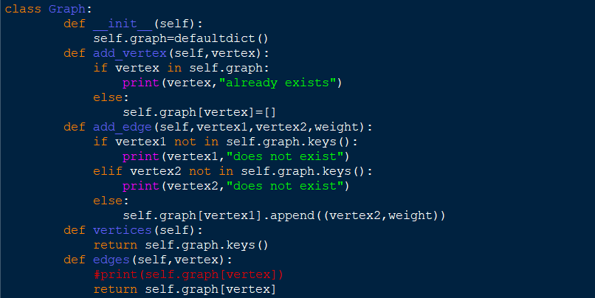
Graphs
Graph data structure is implemented in this project where the vertices of the graph denote Person classes that are members of the FamilyTree class and the edges represent the directed connections of the familial relations .

Slide 14
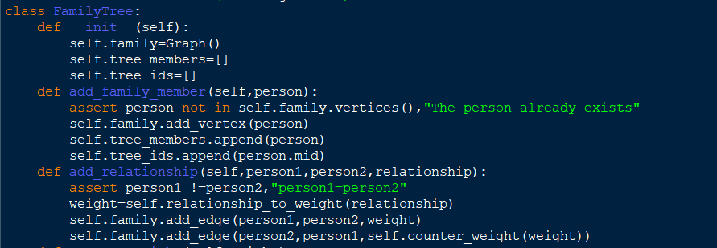
The family tree is represented as a graph using an adjacency list (self.graph in Graph class).

Slide 15
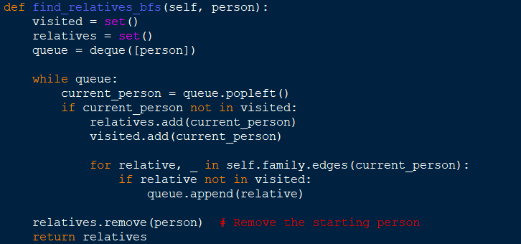
Breadth_First_Search Algorithmof Traversal operation of the graph is implemented in the function find_relatives_bfs to find the relatives in the family of a specific family member.
Breadth-first search is a specific traversal algorithm that explores nodes level by level, starting from a selected node.It is efficiently used in this project in the method to find the ancestors of an individual as well as in other searching requirements.

Slide 16
FUNCTIONALITIES PROVIDED
i)Visualise current Family Tree
ii)Add New Family Member
iii)Add New Family Member relationship with existing members
iv)Visualise a family member’s information
v)Edit Family Member’s information
vi)Edit Family Member’s relationship
vii)Delete a family member
viii)Find the relatives of a family member
ix)Visualize the Family Tree

Slide 17
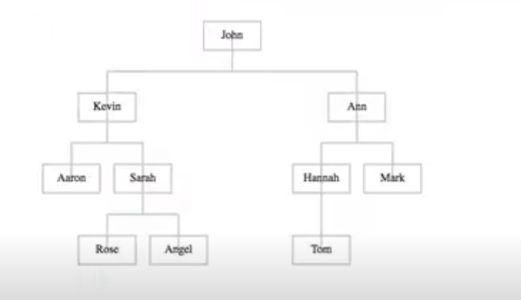
VISUALISING THE FAMILY TREE
For visualising the different components of the family tree,we are using Django to integrate the python program with D3.js
We are aiming to represent the tree in the below manner

Slide 18
Once a particular node of the family tree is created,it is sent to the D3.js code as following
Var data=[{child:’’},{mother:””},{father:””},{brother:” “},{sister:””},{spouse:” “}]

Slide 19
INTEGRATION OF FRONT END & BACK-END
For integrating our project front-end(Java Script) and back-end(Python),we are using Flask API.
We would use HTML and CSS for building other components of our website

Slide 20
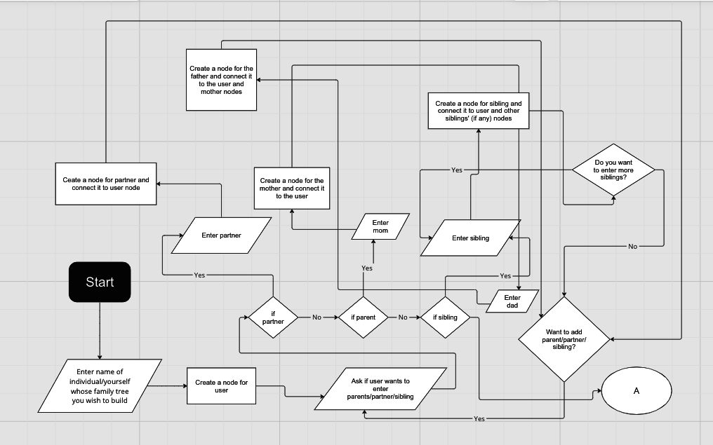
Input/output cycle using a flow-chart depiction
No

Slide 21
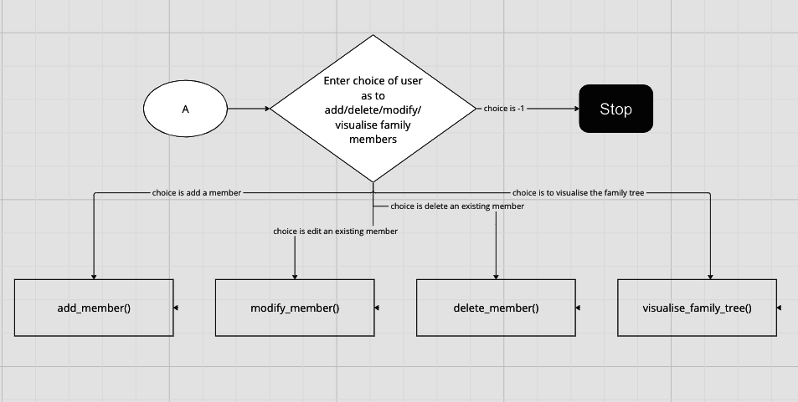
Input/output cycle using a flow-chart depiction

Slide 22
SCOPE FOR IMPROVEMENT
At present,we are aiming our project to be launched as a website,enabling the user to create and edit their family tree.
IMPROVEMENTS:
i)launching our project in the form of an app
ii)Enabling multiple users to use our website at the same time
iii)Incentivizing the user’s experience in using our website
iv)Providing options for users to save their family tree in various forms
v)AnalYzing and establishing connections amongst various family trees-taking inspiration from websites like gramps

